Slide 1
Fast Archiver Plugin

Slide 2
What is Fast Archive
The Fast Archiver plugin uses an rsync-inspired algorithm to transfer archives from slaves to a master. The result is that builds complete faster and network bandwidth usage is reduced.

Slide 3
Benefits: Fast Archive
The Fast Archiver plugin takes advantage of the fact that there are usually only incremental changes between build artifacts of consecutive builds
Saving network bandwidth

Slide 4
Where do we start?
The Fast Archiver plugin is automatically installed and enabled if you have downloaded CloudBees Jenkins Enterprise. This plugin takes over the built-in artifact archiving functionality in Jenkins. If you are already using that feature, no configuration change is needed to take advantages of this feature.

Slide 5
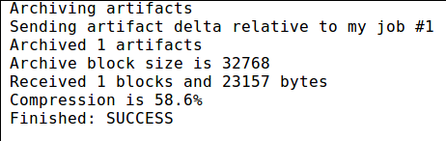
Where do we start?(Cont.)
Note
Note that fast archiving only occurs on builds run on a slave, not those run on the Jenkins master. Also there must have been previous builds which produced artifacts for the new artifacts to be compared to. Otherwise, Jenkins will perform a regular complete artifact transfer. It will do the same if the fast archiver detects that data is corrupted due to an internal bug.

Slide 6
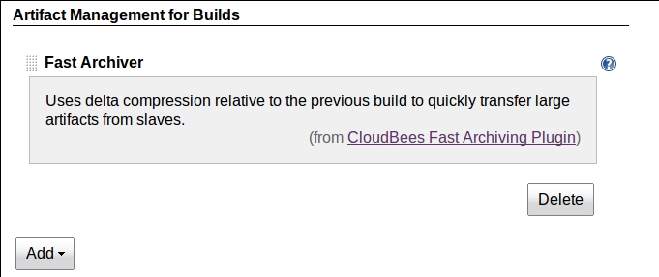
Where do we start?(Cont.)
Normally you need do nothing to configure fast archiving. As can be seen in Figure 8.2, “Fast archiving configuration”, this “artifact manager” is enabled by default when the plugin is first loaded. However you can remove this strategy and later read it in the main Jenkins configuration screen

Slide 7
Lab Exercise:
Fast Archive

